Slide 1

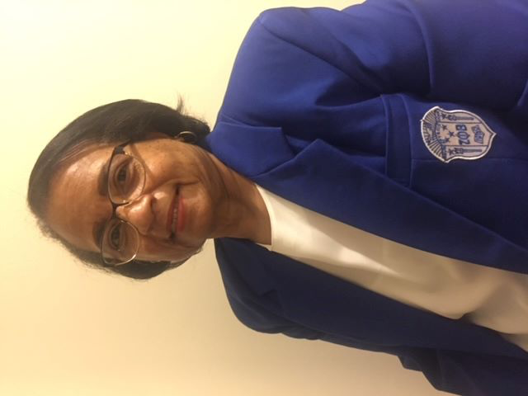


PHI BETA SIGMA FRATERNITY, INC.
TAU NU SIGMA CHAPTER
Presents
BLACK HEALTH MATTERS LECTURE SERIES
Hypertension
in the Black Community
Guest Speaker: Marquetta L. Faulkner, MD, MBA, FACP, FASN
Date: September 14, 2023 Time: 7 PM
Join Zoom Meeting
https://us02web.zoom.us/j/88431904291?pwd=NnVQTzZ5MVplUEt3bWkxK0E4UnNOdz09
Meeting ID: 884 3190 4291
Passcode: 118185

